Slide 1


EPCC’s PRACE Advanced Training Centre
Software Carpentry boot camp
3-4 December 2013

Slide 2


Slide 3
Six PRACE Advanced Training Centres (PATCs)
Hubs for world-class HPC training for researchers in Europe
http://www.training.prace-ri.eu
Barcelona Supercomputing Center (Spain)
CINECA - Consorzio Interuniversitario (Italy)
CSC - IT Center for Science Ltd (Finland)
EPCC at the University of Edinburgh (UK)
Gauss Centre for Supercomputing (Germany)
Maison de la Simulation (France)

Slide 4






EPCC’s PATC
EPCC runs the UK National Supercomputer ARCHER
Cray XC30, a tier-1 resource in PRACE
A long history of HPC training
One year Masters course in High Performance Computing since 2001
http://www.epcc.ed.ac.uk/msc

Slide 5
PRACE support
PRACE also funds catering and other expenses for PATC courses
Please fill in the course feedback form!
linked in from the registration page
opens on last day of course

Slide 6


The Software Sustainability Institute
Software training and skills for researchers
Recognition of software as a first-class research output
Research software developer career path
Better software => better research

Slide 7
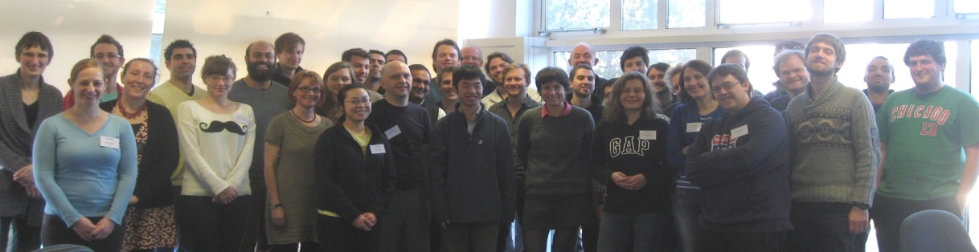
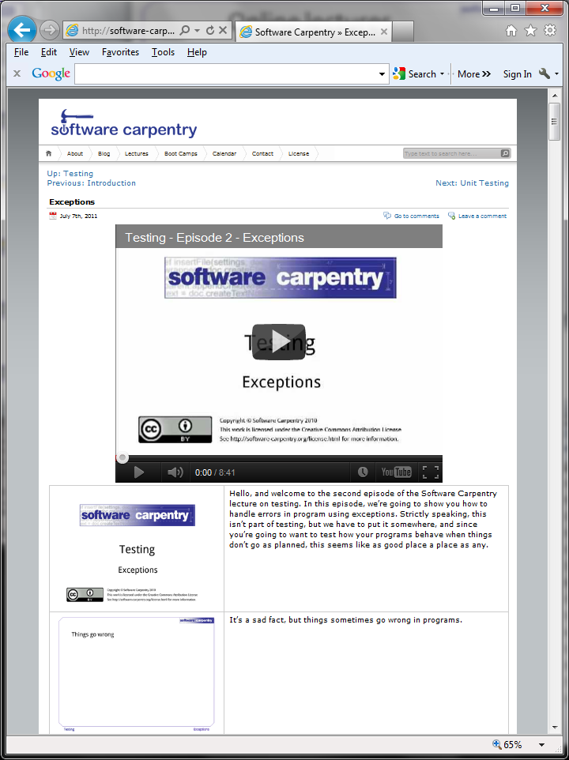
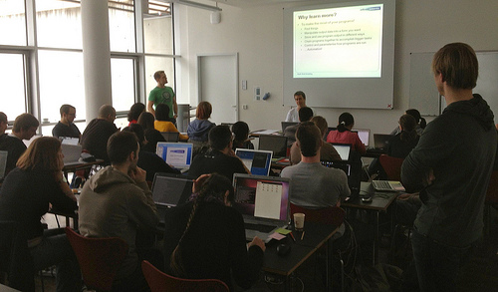
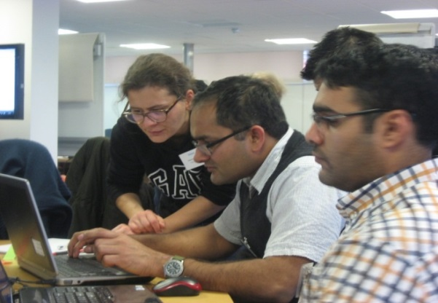
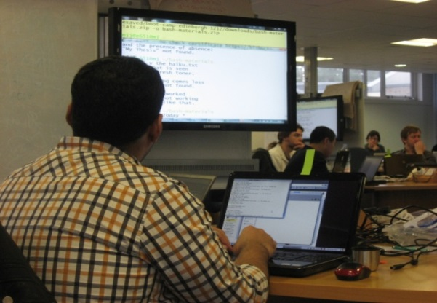
Software Carpentry

Slide 8
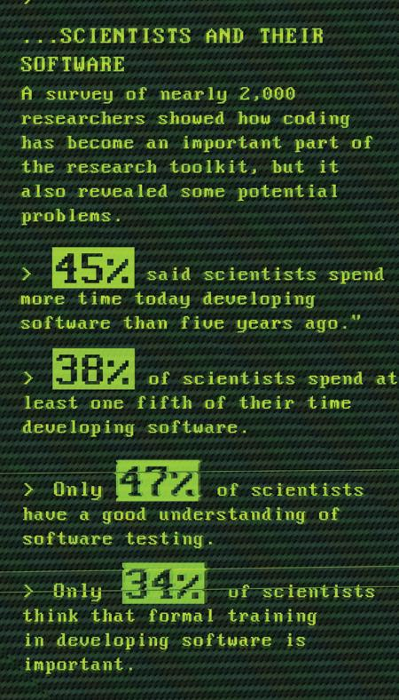
Why bother?
Hannay et al, “How Do Scientists Develop and Use Scientific Software?
SECSE '09 Proceedings of the 2009 ICSE Workshop on Software Engineering for Computational Science and Engineering, IEEE Computer Society, 2009. DOI: 10.1109/SECSE.2009.5069155

Slide 9




But we’re not software developers…
or

Slide 10

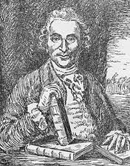
A bit of history
Courtesy of the National Library of
Medicine
Cider | Sea water
Sulphuric acid (!) | Oranges
Vinegar | Barley water
1754-1763 – 7 Years War
Britain loses 1512 sailors to enemy action…
…and almost 100,000 to scurvy
1747 – (possibly) the first ever controlled medical experiment
1794 – the Admiralty gave it ago and England rules the waves
Notes:
Scottish surgeon James Lind (1716-94) found a solution
12 sailors, divided them into 6 pairs
Sailors who were given oranges were back on their feet in just a few days, while the others continued to sicken
British expeditions that went into the South Pacific and around Africa took lime trees with them
Many historians believe that one of the key reasons England came out of Napoleonic Wars on top

Slide 11



Them’s fightin’ words…
“Many software researchers advocate rather than investigate” – Robert L. Glass (2002)
+
Notes:
“As a result, (a) some advocated concepts are worth far less than their advocates believe, and (b) there is a shortage of evaluative research to help determine what the value of such concepts really is”
In software engineering this is par for the course, perhaps with a brief reference to an article from some guy over there who happened to agree.
It’s not proof. Not science.
“probably true that this is the most contentious fact in this book”.

Slide 12
For starters…
“Regardless of whether one is dealing with assembly language or compiler language, the number of debugged lines of source code per day is about the same!” (Corbato 1969)
“The number of lines of code a programmer can write in a fixed period of time is the same independent of the language used.” – Corbato’s Law
“performance variability that derives from differences among programmers of the same language … is on average as large or larger than the variability found among the different languages.” (Prechelt, 2000)
Notes:
Prechelt, L. An Empirical Comparison of Seven Programming Languages, IEEE Computer, October 2000, pp23-29.
http://citeseerx.ist.psu.edu/viewdoc/download?doi=10.1.1.113.1831&rep=rep1&type=pdf
C, C++, Java, Perl, Python, Rexx, and Tcl.
Corbató, F. J. (6 May 1969). "PL/I as a Tool for System Programming". Datamation 15 (5): 68–76.
Corbató's Law
Aim high, get it correct, then worry about optimisation

Slide 13
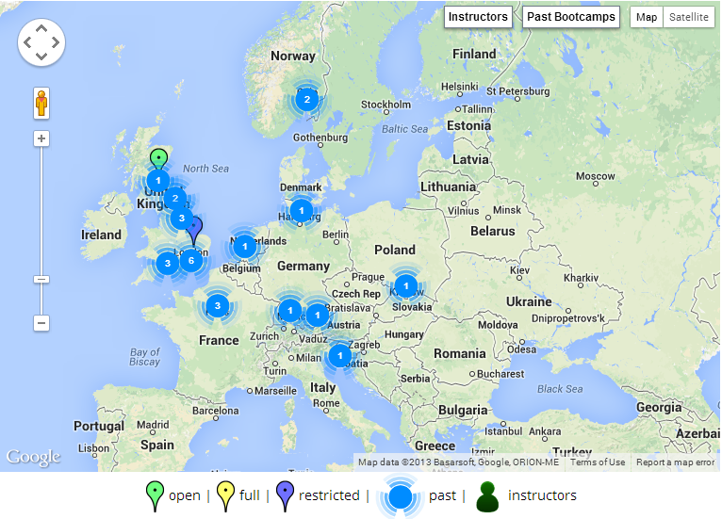



Want to get involved?
Grab us during a break!
admin-uk@software-carpentry.org
http://software-carpentry.org/bootcamps

Slide 14
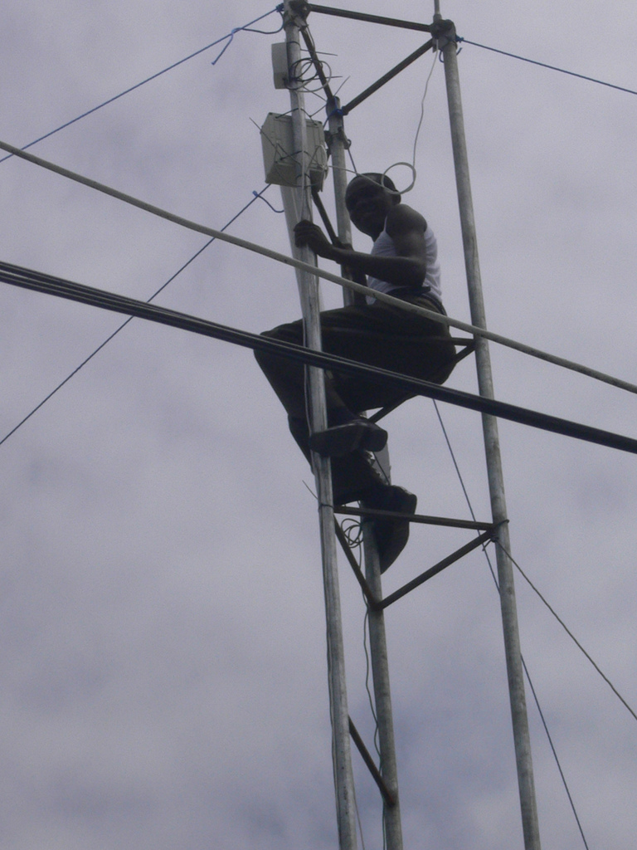
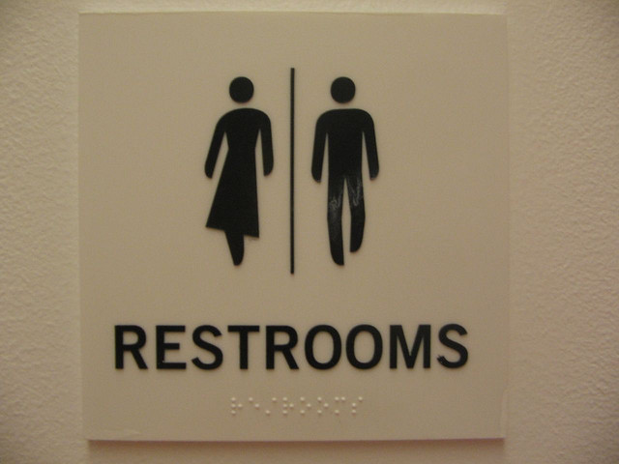


Important stuff
Images courtesy of (clockwise from top-left) oneVillage initiative, Bobbymond, Dajanda, Anton Novojilov

Slide 15
Meet’n’greet
Your helpers are…
…there for you!
Your PostIt’s
Red – I’m stuck, help!
Green – I’m fine

